Slide 1
Fast n Furious Transforms

Slide 2
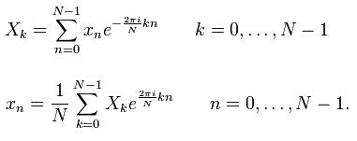

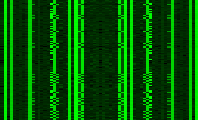
Welcome to my Journey
Fourier Transform
struct _unknown
{
byte typeField;
short lenField;
char[] dataField;
}
Pitch Detection
Signal Visualization
Protocol Analysis

Slide 3
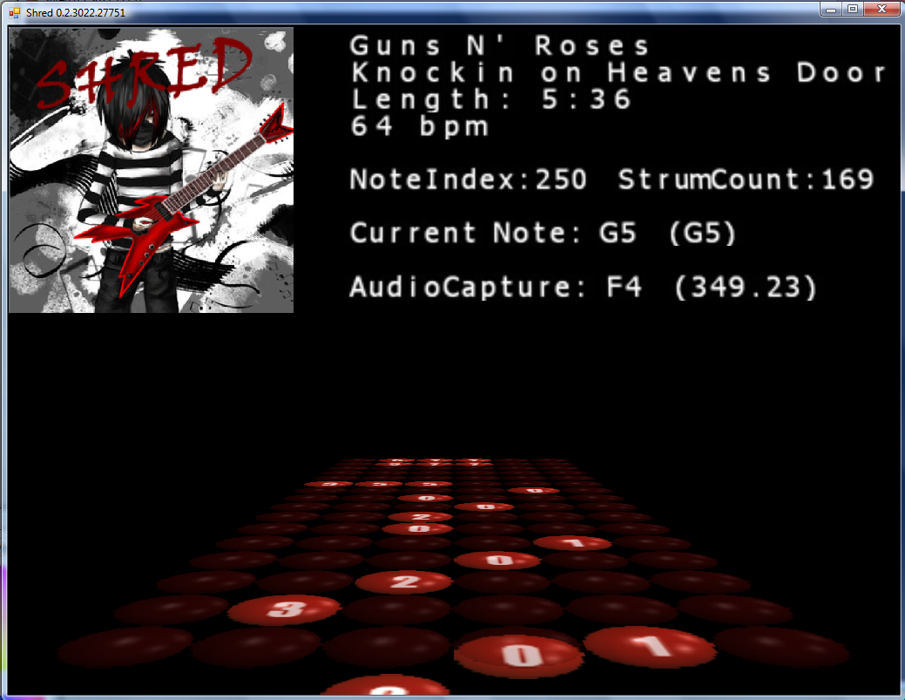
SHRED
SHRED is a proof of concept music education software tool

Slide 4
SHRED
SHRED is the first software of its kind that it uses real-time signal processing to analyze a live performance
Use real musical instruments or voice as an input device

Slide 5
How SHRED Works
SHRED parses standard tablature file formats to obtain fret board finger positions
Chords are synthesized internally to determine the chord’s pitch
Microphone audio is processed real-time to determine the player’s accuracy

Slide 6




Fourier Analysis
Fourier Analysis is a technique for decomposing compound signals into their component waveforms.

Slide 7
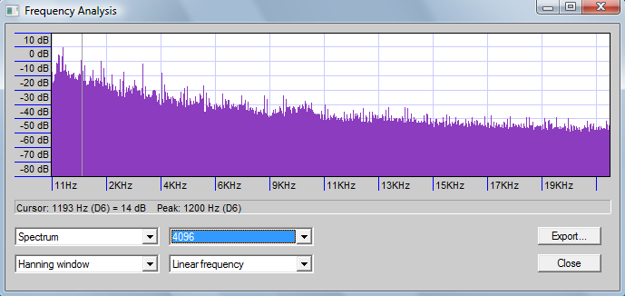
Fourier Transform
Samples of waves captured over a period of time can be converted into their frequency spectrum via a Fourier Transform.

Slide 8
Discrete Fourier Transform
The Fourier Transform attempts to detect the presence of a frequency by multiplying the original wave with the basis wave function
int N = input.Length;
ComplexF[] output = new ComplexF[N];
double sinWave, cosWave;
for (int k = 0; k < N; k++)
{
sinWave = cosWave = 0;
for (int n = 0; n < N; n++)
{
cosWave += input[n].Re * Math.Cos(-2 * Math.PI * k * n / N);
sinWave += input[n].Re * Math.Sin(-2 * Math.PI * k * n / N);
}
// Magnitude
output[k] = (ComplexF)Math.Sqrt(Math.Pow(cosWave, 2) + Math.Pow(sinWave, 2));
}

Slide 9
Discrete Fourier Transform
The sum of the products from the multiplied wave represents the magnitude or overall presence of the basis wave.
int N = input.Length;
ComplexF[] output = new ComplexF[N];
double sinWave, cosWave;
for (int k = 0; k < N; k++)
{
sinWave = cosWave = 0;
for (int n = 0; n < N; n++)
{
cosWave += input[n].Re * Math.Cos(-2 * Math.PI * k * n / N);
sinWave += input[n].Re * Math.Sin(-2 * Math.PI * k * n / N);
}
// Magnitude
output[k] = (ComplexF)Math.Sqrt(Math.Pow(cosWave, 2) + Math.Pow(sinWave, 2));
}

Slide 10
Fast Fourier Transform
Any optimized implementation of the DFT
Example: Cooley-Turkey
Recursively breaks down DFT into smaller DFTs
Number of samples must be factorable
DFT complexity: O(N) ²
FFT complexity: O(N log N)

Slide 11
Question!
How can we encode arbitrary data as a waveform?

Slide 12
Noise in the Data
Sine wave:
Direct encoding:
Each basis wave can carry one piece of information
Complex waves carry multiple bits of information in a specific order
double theta = (2.0 * Math.PI) * (_frequency / _samplingRate);
values[i] = _amplitude * Math.Sin(theta * i + phase);

Slide 13
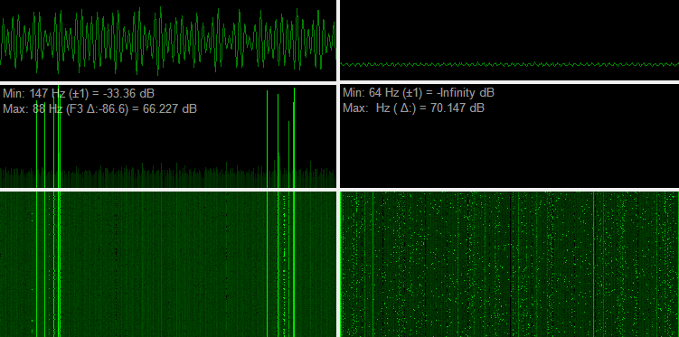
Visualizing Polymorphism
alpha_mixed
shikata_ga_nai

Slide 14
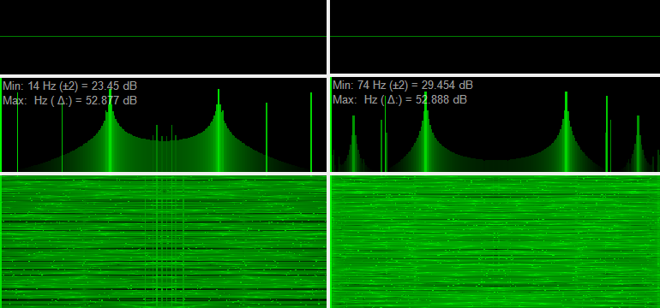
Visualizing Polymorphism
call4_dword_xor
shikata_ga_nai

Slide 15
Tuning In
Windowing the data allows us to find pure signals...
Full packet visualization will not transmit much information
Enumerations and type fields become immediately apparent!

Slide 16
Why all the Noise
This is a proof of concept that may be expanded
Encoding properties as waves allows magnitude to represent reoccurrence of patterns
Different attributes such as amplitude can be utilized to represent distance from a target

Slide 17
Thank You
More info:
IIT CS Lectures on You Tube
http://rjohnson.uninformed.org

